Slide 1
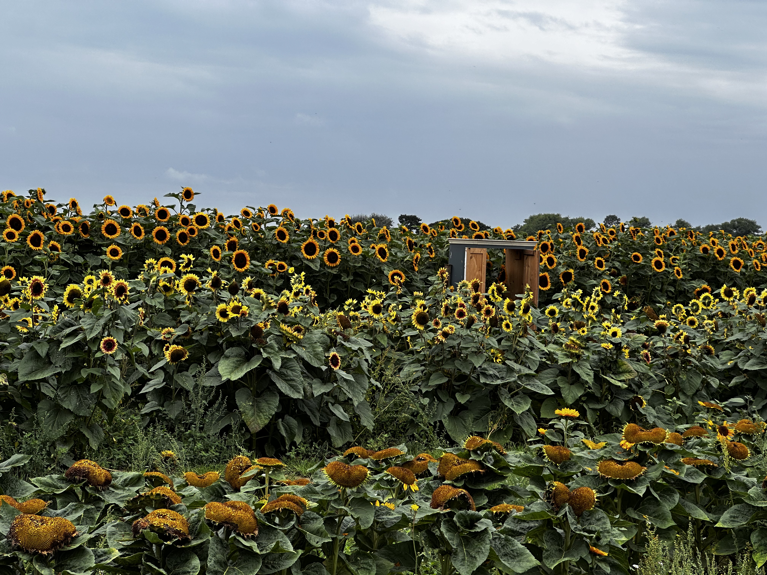

HAYLING ISLAND
HAYLINGS ISLAND
Hayling Island’s Sam’s Sunflowers is a charming seasonal spot where vibrant sunflower fields stretch across the landscape, inviting visitors for a wholesome, nature-filled day out.
Pick-your-own sunflowers with stunning backdrops for photos
Family-friendly activities and open fields to explore
Local produce and refreshments often available on-site

Slide 2
HAYLING ISLAND
HAYLINGS ISLAND
Hayling Island’s Sam’s Sunflowers is a charming seasonal spot where vibrant sunflower fields stretch across the landscape, inviting visitors for a wholesome, nature-filled day out.
Pick-your-own sunflowers with stunning backdrops for photos
Family-friendly activities and open fields to explore
Local produce and refreshments often available on-site

